Slide 1
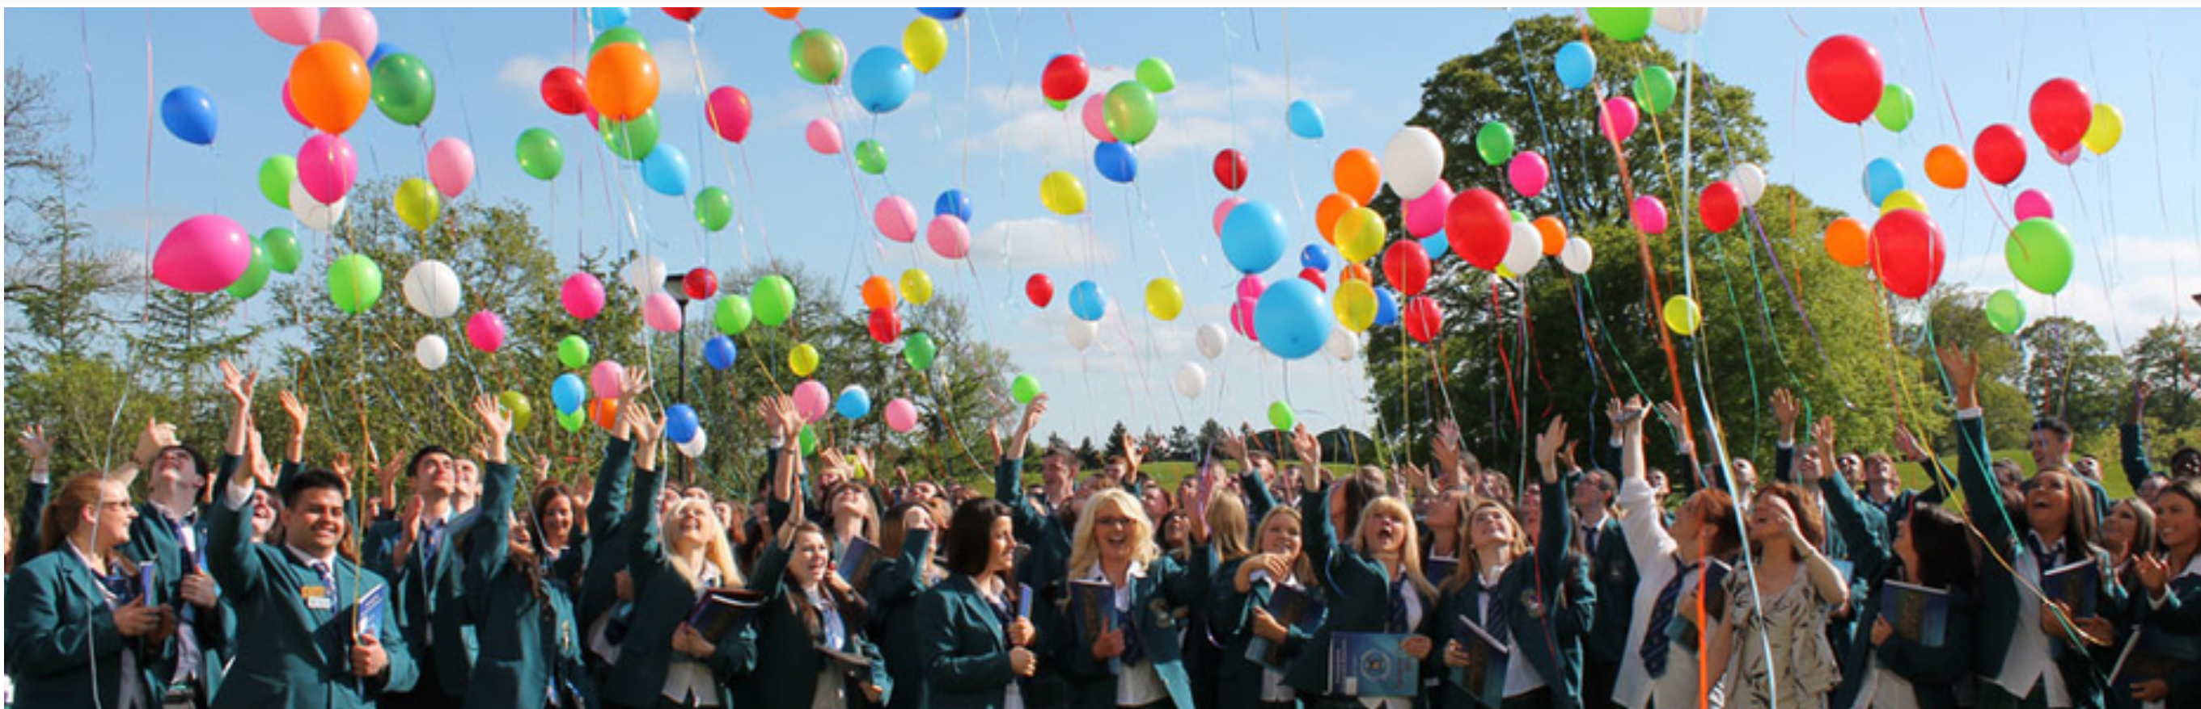

CCC Parents Association
Annual General Meeting
12th October 2023
Fáilte – Mol an Óige agus Tiocfaidh sí

Slide 2
Agenda
Welcome
Summary of 2022 AGM minutes
Role of the Parents Association for new parents
Sept 2022 to Sept 2023 Year in review:
  Review of College policies
  Debs
  Uniform sales
  Mock interviews
  Learning support
  Talk for parents
  Plant sale
  College extension

Slide 3
Agenda
Thank You
Treasurers Report
Election of PA Officers and PA Nominee to the BOM
Update John Cronin – Principal
Chairpersons address
AOB

Slide 4
Summary of 2022 AGM Minutes
  Chairperson – Liam O Flannagain
    Approved 2021 Minutes
    Review of activities – Sept 2021– Aug 2022
    A huge Thanks to all volunteers
    Election of Parent Representative to the Board of Management and Chairperson of the PA
    Financials
    Principal’s Address
  Minutes Circulated post the 2022 AGM and pre 2023 AGM, so taken as read

Slide 5
Role of Parents Association for New Parents
  Partnering with the school management and staff
  Arrange talks of interest for parents throughout the academic year
  Mock interviews
  Readers for inhouse exams
  Policy review for school – parental input
  TY Pool
  Fundraising & fun – e.g. plant sale / raffle /2nd hand uniform sale
  Support the college where required e.g. lobbying
  Meet 1st Monday of the Month @ 7:30pm (room 10)

Slide 6
Sept 2022 to Aug’23 Year In Review
Review of College policies
Debs LC 2023
Uniform sales
Mock interviews
Learning support
Talk for parents
Plant sale
College extension

Slide 7


Review of College Policies
Child Safeguarding Statement
Counter Bullying Policy
Acceptable Device Usage
Data Protection

Slide 8


Debs LC 2023
Class of 2023 event held on 29th September in the Carnegie Hotel in Swords
PA Rep on the Debs Committee attends a number of calls with Debs Ireland re venues and themes
Acts as liaison between Debs Ireland and the Debs Committee (Students)
Thanks to Grainne Kehoe for being the PA Rep and 1-2 volunteers required to support Grainne

Slide 9
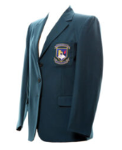



Uniform Sales
June 2023 sale raised €2,761 and September 2023 circa €100
These monies will be donated to Pieta House
Great initiative with the current cost of living challenges and positive environmental impact
Thanks to Marie King for organising this for several years and who is now stepping down and Tina Gao who will now take the lead

Slide 10
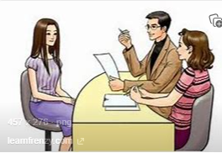

Mock Interviews
Decision was made to keep the numbers small
First face-to-face interviews since pre Covid
Interviewed LC2 LCVP & LCA students, a trial run for their LC interview
15-20 minute interview , followed by 5 minute feedback session
PA works very well with the school in the preparation and execution of this evening
We will build back up to interviewing the wider 6th year student group in 2023 ( Thurs 26th October 2023)
Big thank you to Lorraine Hagerty

Slide 11

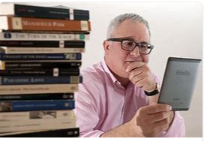
Learning Support
Over 20 parents involved
Provide reader support for house exams
Some of these parents provide support for state exams
Important roles in a stressful situation so trust & calmness is crucial
Very rewarding so please volunteer
Thank you to Sinead Morrissey Fallon for leading this

Slide 12
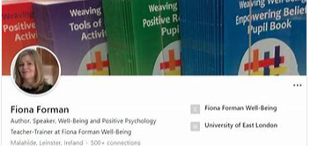
Talk for Parents
In March in conjunction with the school the PA organised a talk for parents with the speaker Fiona Forman
Presenting a talk on “Raising Resilient Adolescents”
Great takeaways for parents
Over 100 parents attending
Plan to do 2 talks in the current academic year
Thank you to Ms O’Neill for her support with these talks down through the years

Slide 13
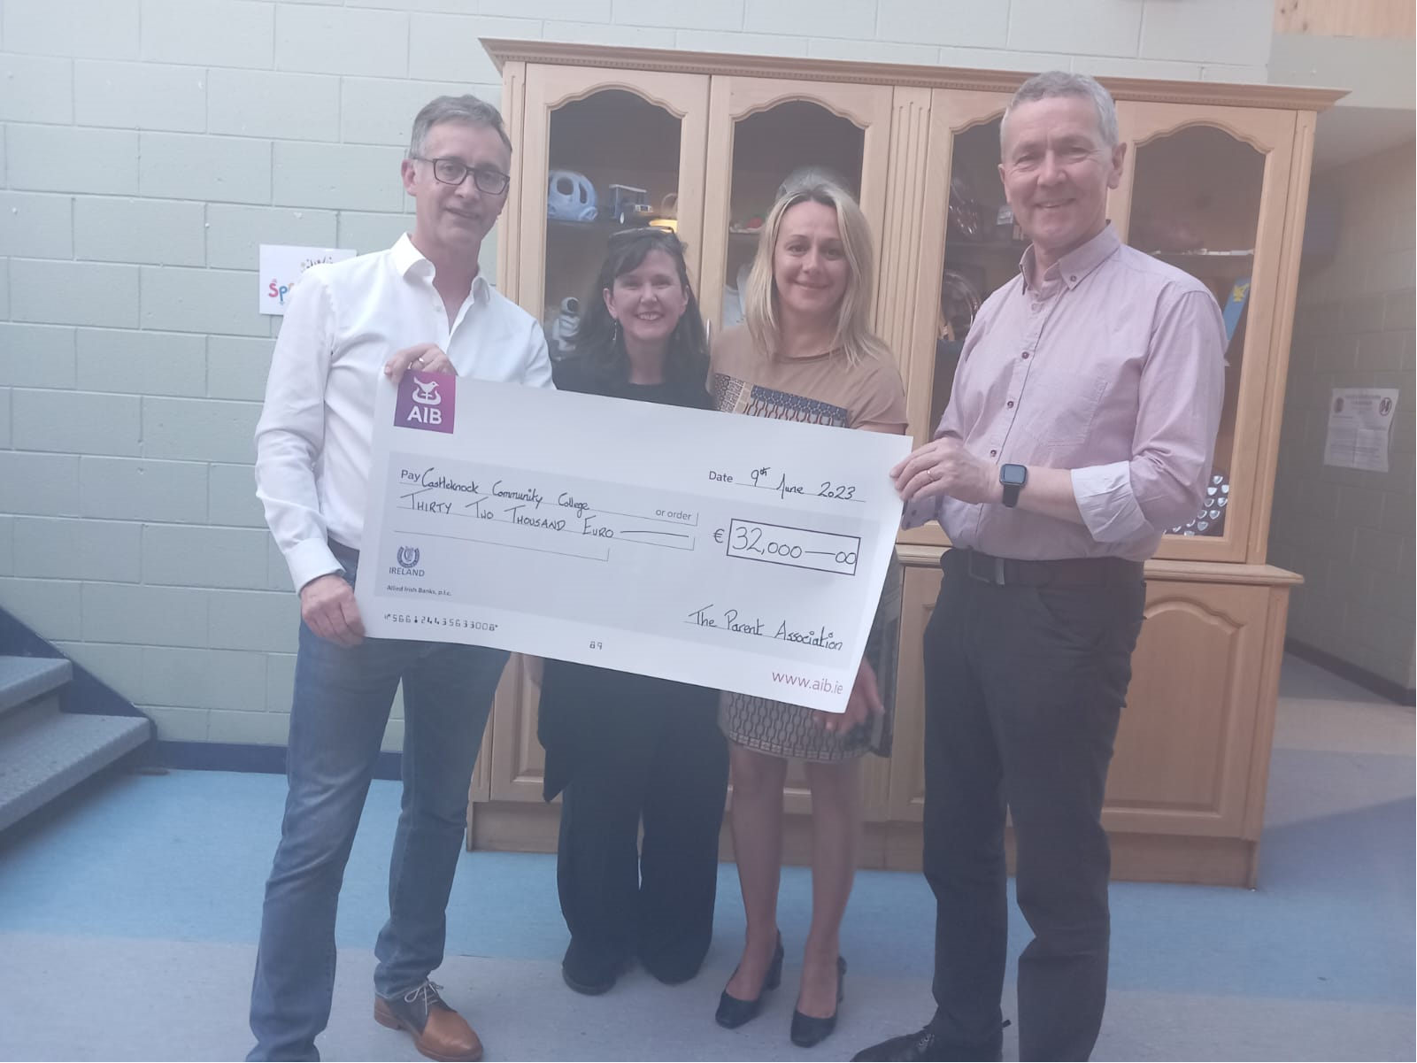
Annual Plant Sale
Major Community event in its 24th year
Create a buzz in the College & locality
Our major fundraiser, profit of €34k in 2023
Parents getting to know one another
Fun
Proceeds used to enhance student’s experience
    Lunchtime arrangements, picnic facilities & separate rooms senior students
    Invest in stage area and musical dept
    IT requirements Learning Support Dept
    A big thank you to Karen Kearney for the fantastic work

Slide 14
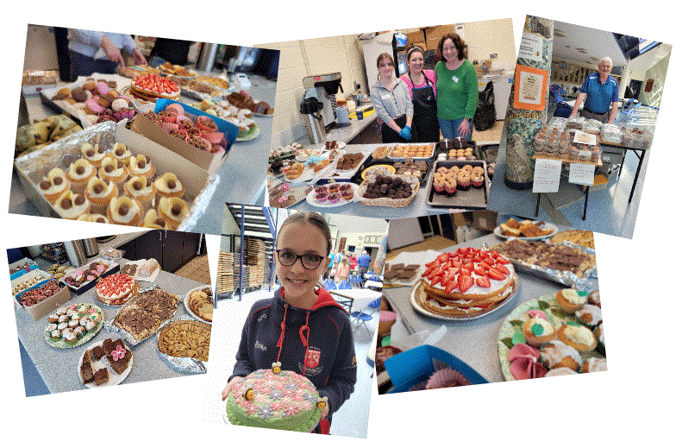
Plant Sale Events

Slide 15
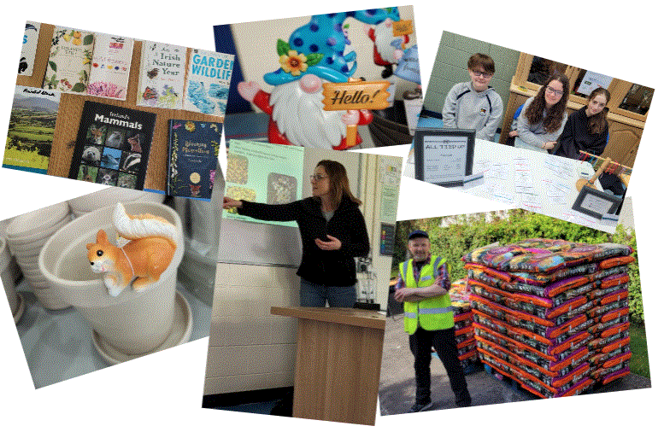
Plant Sale Events

Slide 16
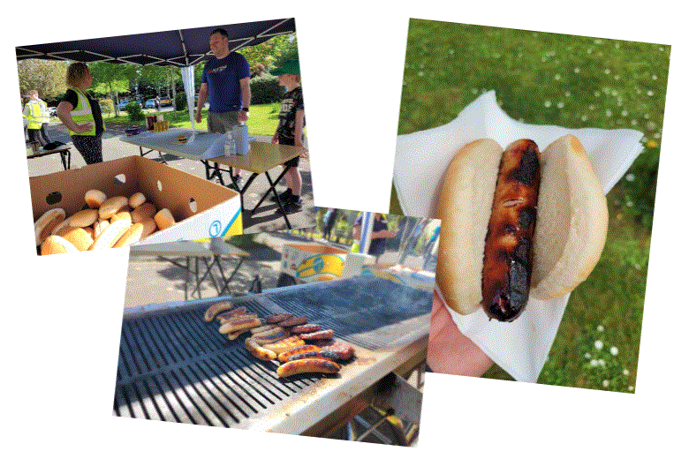
Plant Sale Events

Slide 17
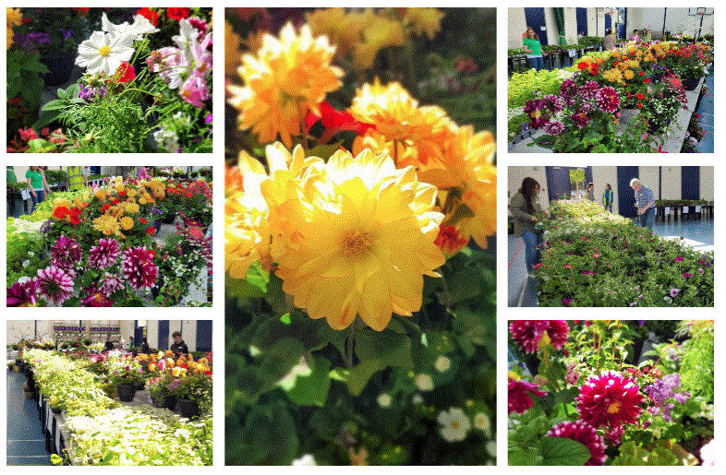
Plant Sale Events

Slide 18
































Sponsors
Castleknock Framers

Slide 19
Raffle Winners & Sponsorship
Main Raffle
Coffee Shop Raffle
  €1,930 in cash donations
  Circa €3k in prizes
  Circa 1K boxes

Slide 20
Key Statistics from the Plant Sale & Raffle
Receipts
Card Split
Transactions
Items Sold
69% Card
31% Cash
85% Visa
15% M-card
1,349 Card
606 Cash
8,475 Plants 208 Pots
Compost
AOV (card)
Raffle
Volunteers
320 Bags
€28.72
680 books
129 parents 42 Students
20

Slide 21
Income & Expenditure
Income
Expenditure
Profit
€62,378
€28,156
€34,221
Profit 55%
  Expenditure:
    Cost of plants & pots
    Printing – Tickets & Flyers
    Signs
    Additional Sum up machines
    Cost of BBQ items
    Sum-up fees - 1.7%
  Income:
    Proceeds from Plants sale
    Main Raffle
    Coffee Shop
    Cake Stall
    BBQ
    Coffee Shop Raffle
    Sponsorship

Slide 22
Income & Expenditure by Event
    55% Profit Margin
    Raffles 14% of Income but 23% of profit
    Plant sale 77% of income but 65% of profit

Slide 23
Learnings
    We need some more people to join the Plant Sale Committee – spread the load
    More Officers i.e. Vice Chair / Asst Treas / Asst Sec etc
    Plant volumes in line with 2019 but no stock from 1:30 pm on Sunday
      Increase qty by 10% = €7k in income or €4k Profit
    Raffle is pure profit grow this by 20% or 138 books = €1.4k profit
    BBQ sell cold drinks, crisps, bars etc
    Sell 20% more Potted Planters / Hanging Baskets (123) = €1.2k profit
    More donations/sponsorship from suppliers/local business and parent’s employers
    Book stall

Slide 24
College Extension
Extension promised in 2021
Understand the challenges of obtaining budget approval and planning
PA disappointed with the speed of progress
Concerns about probable reduced intake of students in future years
College not meeting its requirements under the Education for Persons with Special Educational Needs Act 2004
PA are pleased with the developments / commitments from all parties that were made late in the last school year
Will be monitoring the situation closely and as to what action the PA need to take to support this project
As part of the Plant Sale the Chairperson of the PA had discussions with local politicians on the concerns that the PA have but pragmatic on the solution & timing of build/phases
The Chairperson also had a separate discussion with An Taoiseach in late April
Updates from Myles Byrne or Anne-Marie Flynn at monthly PA meetings

Slide 25
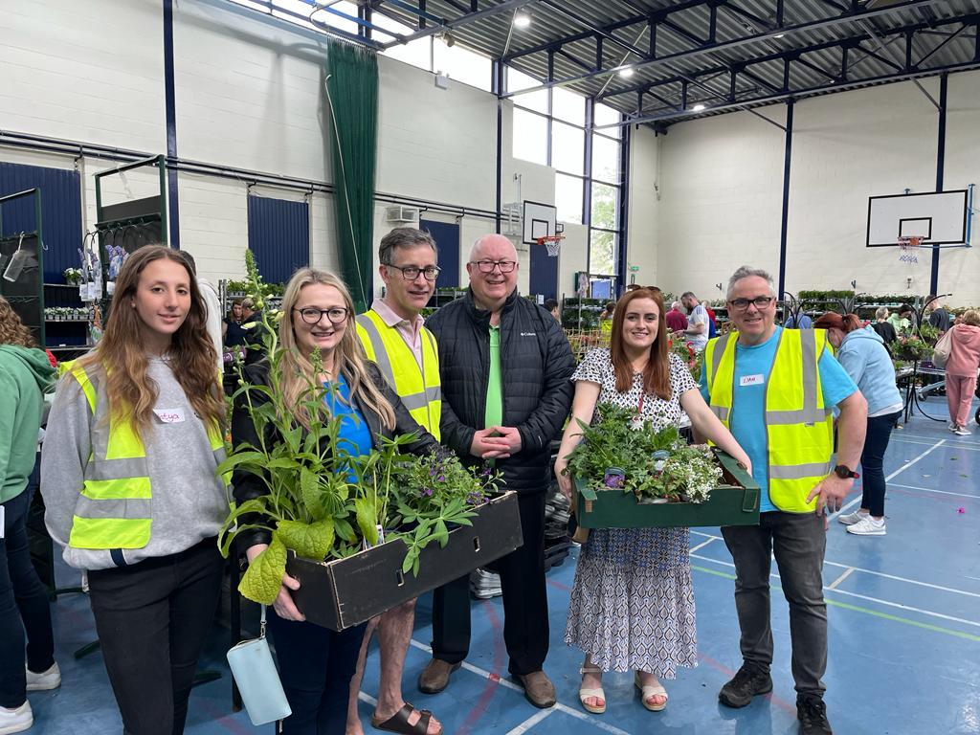
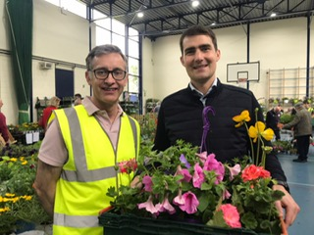
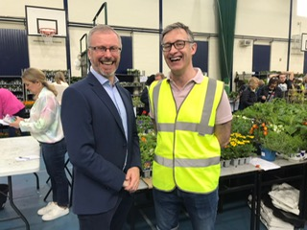
Politicians – College Extension
  Who did we get time with to stress the Importance & Urgency?
    Jack Chambers - Minister
    Roderic O‘Gorman - Minister
    Eimer Currie - Senator
    Siobhan Shovlin – Councillor / ETB
    Howard O’Mahony – Councillor / BOM
    John Walsh – Councillor / BOM Chair
    Leo Vardaker An Taoiseach
    (At home)
    With Local Elections in May/
    June 2024 and Dail Elections
    by March 2025 canvas support
    from our elected representatives
    and candidates for election

Slide 26
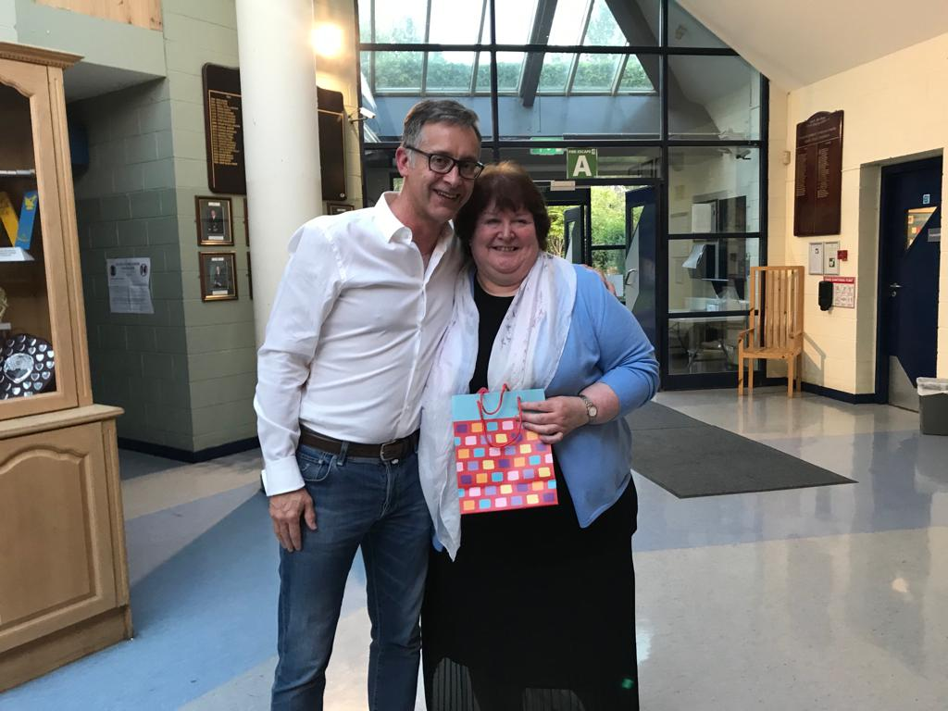
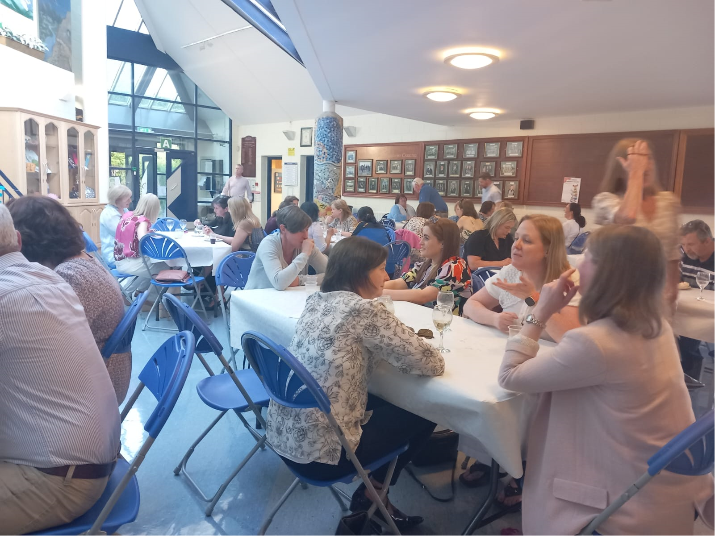
Thank You
The PA would finally like to say thank you Ms O’Neill for the contribution to the school and students over the past 27 years and for being a great supporter of the PA.
This year we will be saying goodbye to key members of the PA and a big thank you to them
  Marie King
  Karen Kearney
  Anne Marie Flynn
  Liam O Flannagain

Slide 27
Treasurers Report – Income & Expenditure
€32,000 donation to the college
No receipts in 2020-2021 due to COVID.

Slide 28
Treasurers Report – Income & Expenditure

Slide 29
Election of PA Officers and PA Nominee to the BOM
Current Parents Association Officers:
  Chairperson: John Goodwin
  Secretary – Denise Doyle
  Treasurer – Natalia Andreeva
  Vice Chair – Karen Kearney stepping down after 6 years daughter LC 23
  A very big thank you to Denise and Natalia
With the amendment to the constitution in September 2023 there are now 3 vacancies and the extension of the Secretary and Treasurer terms.
  Vice Chair
  Assistant Secretary
  Assistant Treasurer

Slide 30
Election of PA Officers and PA Nominee to the BOM
Current PA Nominees to the BOM:
  Anne-Marie Flynn stepping down after 5 years
  Myles Byrne (Oct 2022)
With Anne-Marie stepping down there is now a vacancy for a female nominee
Thank you to Anne-Marie and Myles

Slide 31
Election of PA Officers and PA Nominee to the BOM
Extension of Terms (2 years) of the PA Officers:
  Treasurer Natalia Andreeva – Proposed by Claire Conroy & 2nd by Stephen Ryan
  Secretary Denise Doyle – Proposed by Claire Conroy & 2nd by Stephen Ryan
Nominations for the PA Officers:
  Vice Chair Stephen Connolly – Proposed by Alison de Lacy & 2nd by John Goodwin
  Asst Treasurer Tina Goa – Proposed by Caitriona O’Sullivan & 2nd by Jean Rogers
Nominations for the PA Nominee to the BOM:
  Niamh Glennane - Proposed by Denise Doyle & 2nd by Natalia Andreeva

Slide 32

Castleknock CC
Parents Association AGM
Thursday 12th October 2023

Slide 33

Mission Statement
Seek to foster respect & dignity
To promote a safe & just environment
An atmosphere of positive encouragement

Slide 34

Partnership
Shared Sense of Responsibility
Mutual Respect
Working together for the good of your child

Slide 35

Communication – Online Updates
Parents of Sixth Years Tuesday 5th September
Parents of First Years Tuesday 12th September
Parents of Third Years Tuesday 19th September
Parents of Second Years Monday 16th September
Open Day (First Years 2024) Wednesday 20th September
Upcoming – CAO Talk Thursday 9th November
(Parents of Sixth Year)z

Slide 36
Parent Teacher Meetings
Third Year Group 1 | Tues 3rd Oct. 2023 | 4.15p.m. - 6.15p.m.
Third Year Group 2 | Tues 10th Oct. 2023 | 4.15p.m. - 6.15p.m.
Leaving Cert 2 & LCA 2 | Tues 24th Oct. 2023 | 4.15p.m. - 6.15p.m.
Leaving Cert 1 & LCA 1 | Tues 7th Nov. 2023 | 4.15p.m. - 6.15p.m.
Second Year Group 1 | Tues 14th Nov. 2023 | 4.15p.m. - 6.15p.m..
Second Year Group 2 | Tues 21st Nov. 2023 | 4.15p.m. - 6.15p.m.
First Year Group 1 | Tues 16th Jan. 2024 | 4.15p.m. - 6.15p.m.
First Year Group 2 | Tues 23rd Jan. 2024 | 4.15p.m. - 6.15p.m.

Slide 37

Forward Planning
Readers & Scribes
The New Challenge - TY & Work Experience!
Mock Interview Thursday 26th October
Uniform Review – New Tender
Policy Reviews ………………………

Slide 38

Policy Reviews
Admissions Policy*
Code of Behaviour & The Suspension & Exclusion Policy
SPHE & RSE
Learning & Language Support Policy
Uniform Policy (New Tender Framework)

Slide 39
    Selection criteria in order of priority
Siblings of students, including past pupils, enrolled at Castleknock Community College. Families who secure a place in the College for the first time from the academic year 2023/24 and who reside outside the defined catchment area or may subsequently reside outside the defined catchment area should note that future siblings of these applicants will be placed in Category 4 of the selection criteria.
Applicants living in the catchment area as outlined on Page 5 of this policy and attending one of the listed Primary Schools.
Applicants living in the catchment area as outlined on Page 5 of this policy and not attending one of the listed Primary Schools.
Siblings of students, including past pupils, enrolled at Castleknock Community College attending a listed primary school not living in the catchment area.
Applicants attending a listed primary school not living in the catchment area.
Applicants from outside the Catchment Area.
Finally, places will be offered to those students on the late waiting list as per date and time of receipt of application form.

Slide 40
Parents Association Account
Opening Balance €1,641.84
Lodgement €32,,000
Expenditure €25,515.09
Balance €8,126.75

Slide 41
Upgrade on Computer Science Rooms & Boys Toilets | 757 | S0115 | School Parents Association | 9647.50
Sensory Garden | 757 | S0115 | School Parents Association | 503.00
New Kiln Art Room | 757 | S0115 | School Parents Association | 5926.80
Courtyard – Racks/ Bike Maintenance & Landscaping | 757 | S0115 | School Parents Association | 9437.79

Slide 42
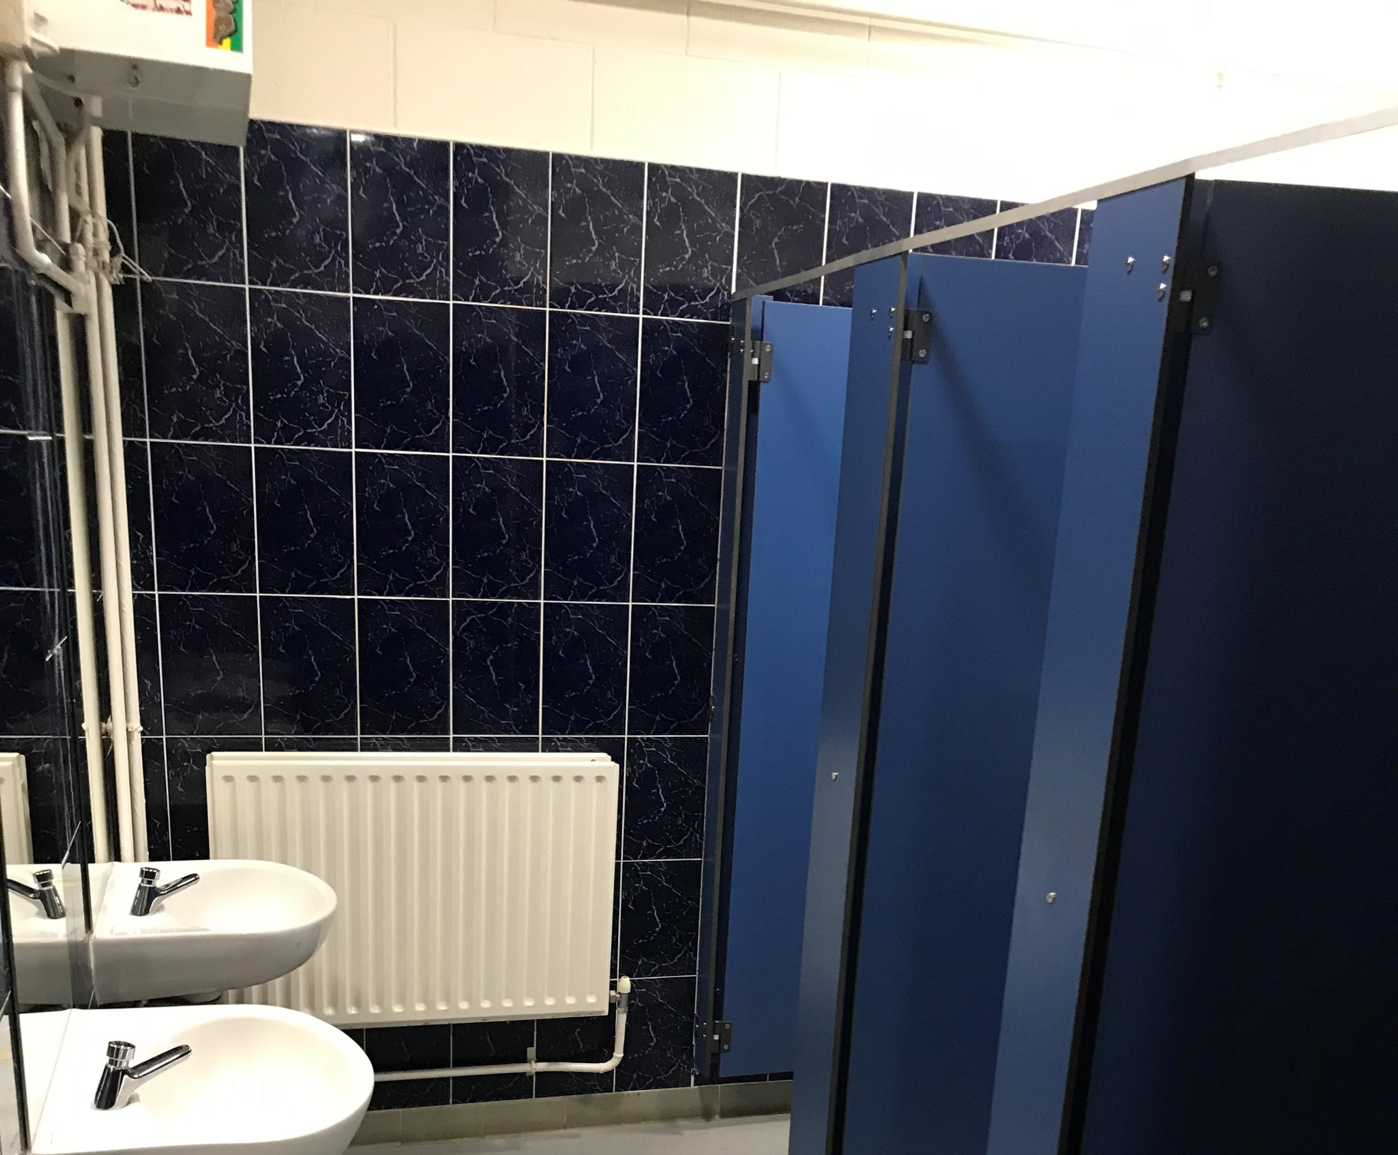
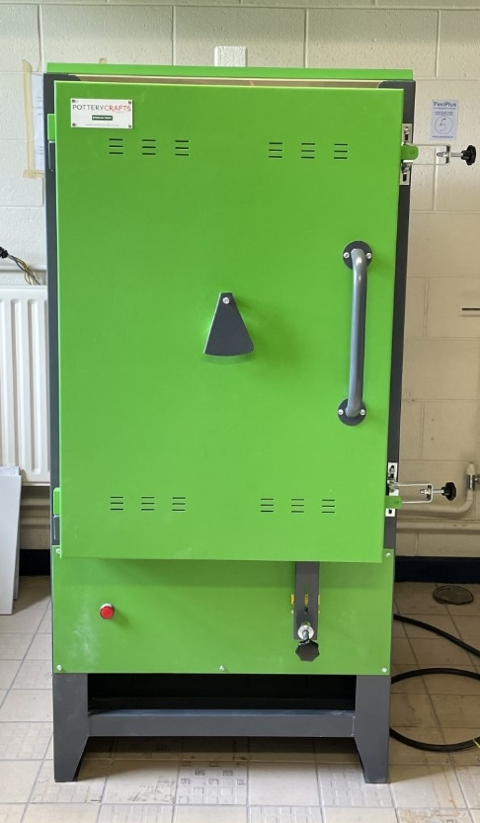
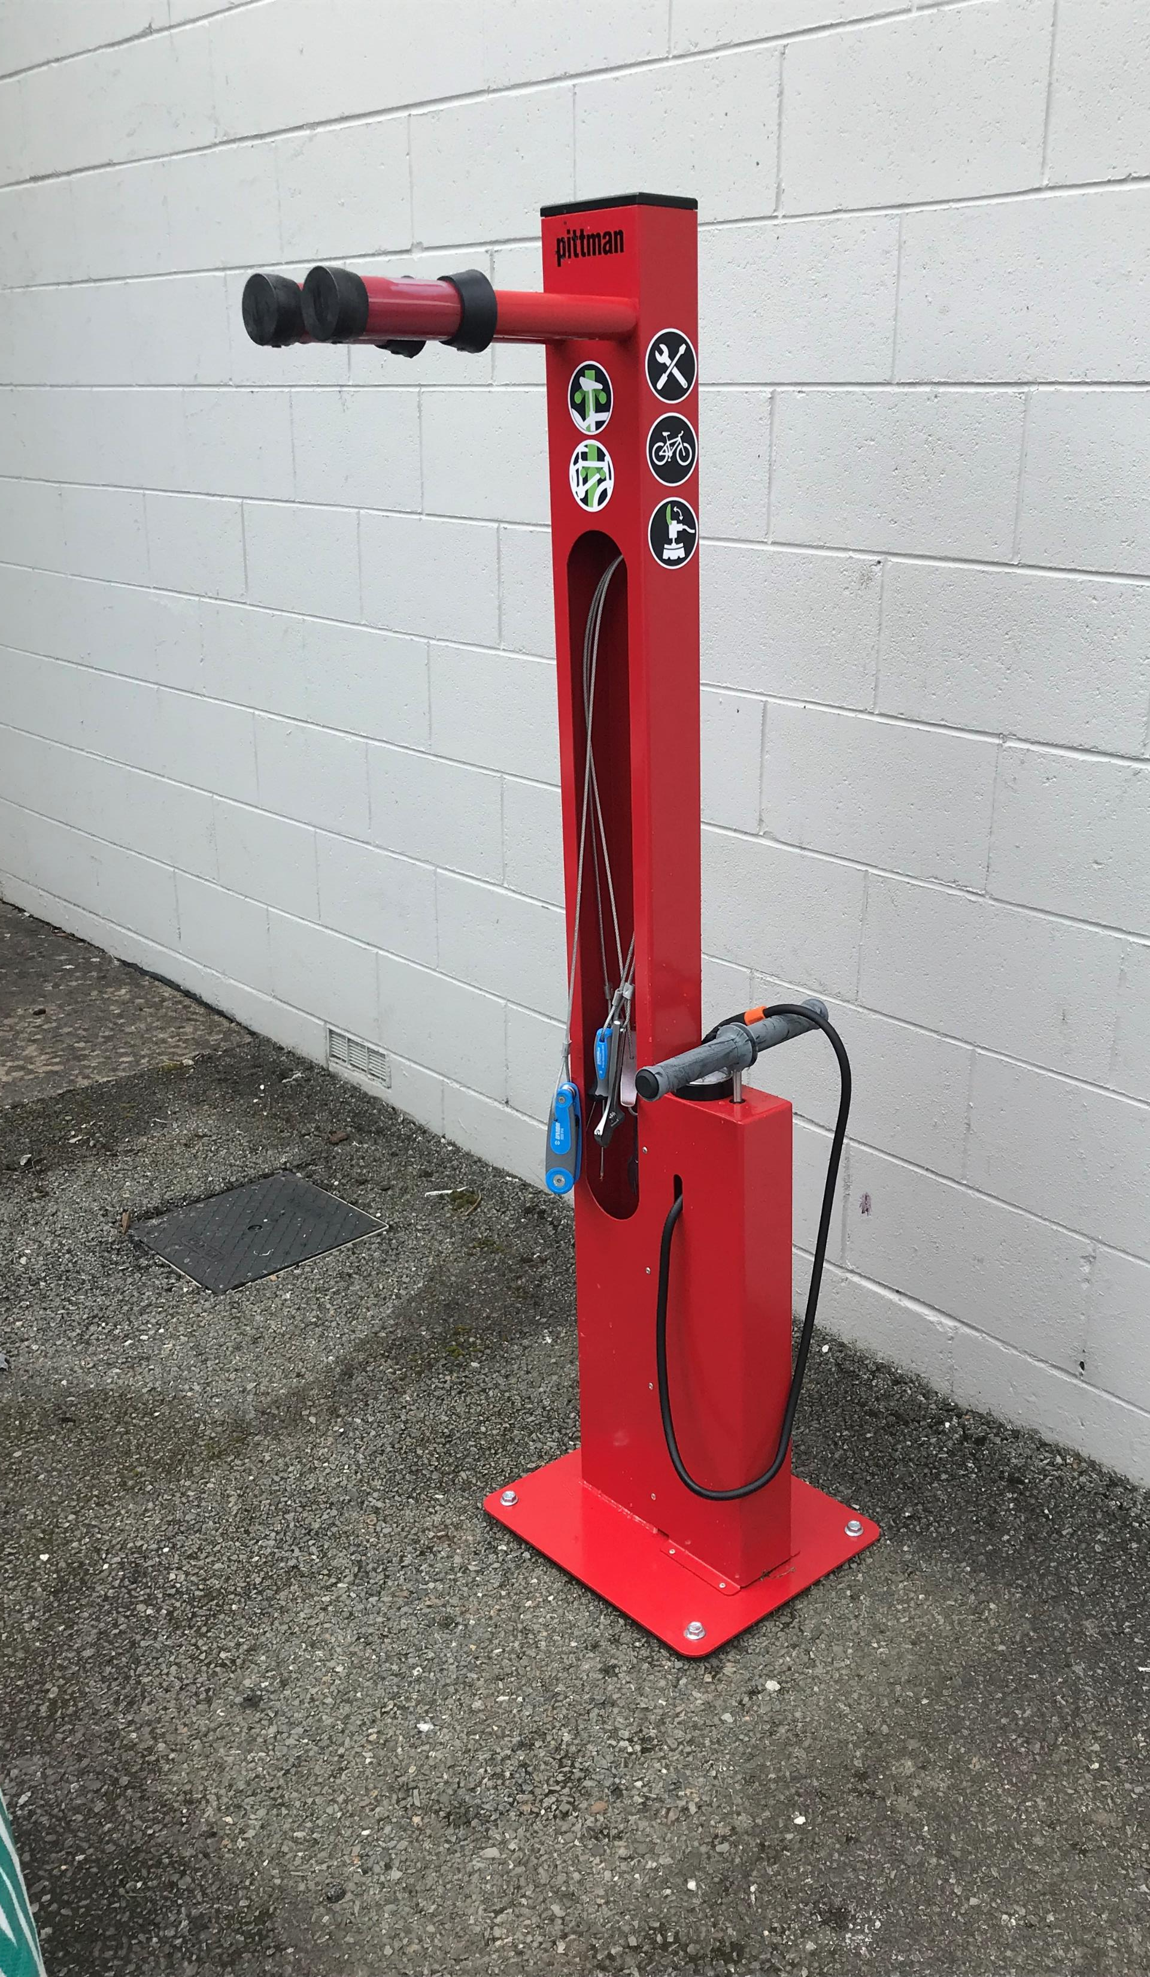
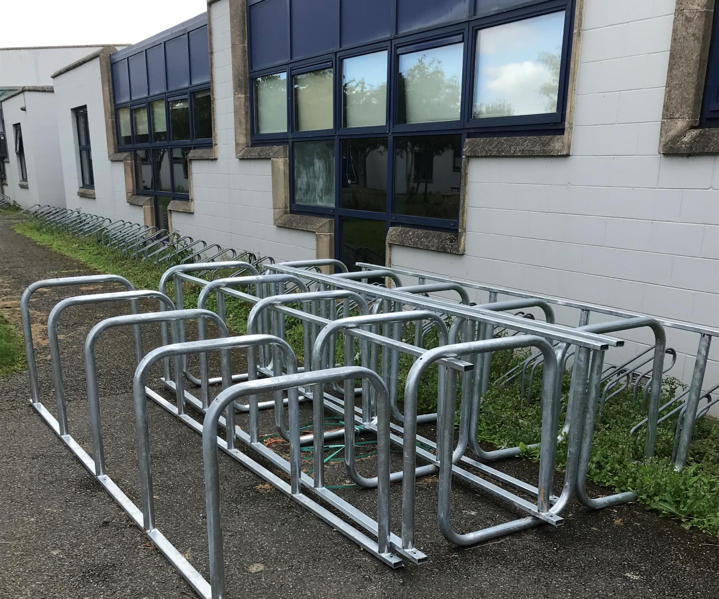

Slide 43
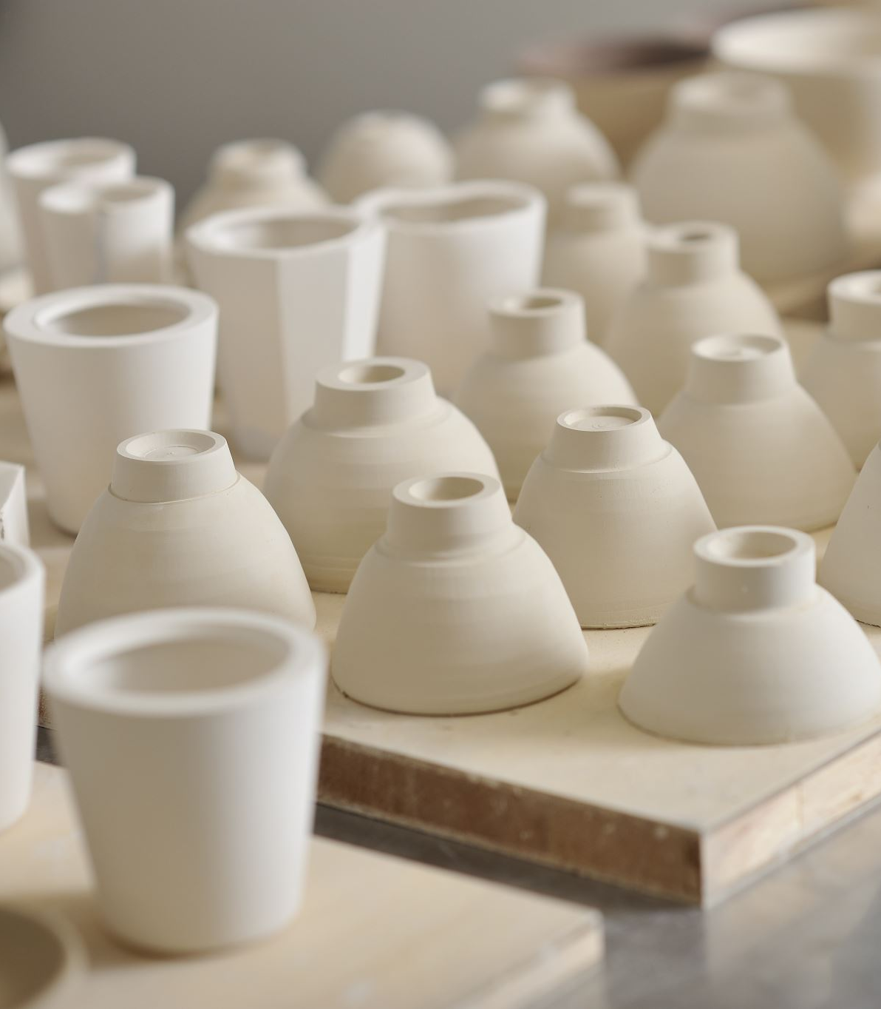
New Kiln For the Art Department
The Art Department would like to say a Big Thank You to the Parents Association for their kind donation towards a new Kiln for the Art Department.
Our old kiln had served us well over the last 22 years but was ready for retirement. As our school specialises in Ceramics we are so grateful to have a new kiln to fire our ware in. Students are particularly excited to see how their glazes turn out.
Ms Woolmington & Ms Havel

Slide 44


Slide 45


Slide 46

Belong To
LGBTQ+ Quality Mark
A support and accreditation initiative for LGBTQ+ safe and supportive schools

Slide 47

Process over 18 months

Slide 48

1. Recognise
Recognise and promote existing supports for your LGBTQ+ school community.
Together we will identify the key strengths in our existing approach to LGBTQ+ inclusion.
Belong To will provide training and resources on how to do this including a user-friendly toolkit which we can use to identify our strengths and areas for development.

Slide 49
2. Build & Grow
Build on these existing supports and grow as an LGBTQ+ Safe and Supportive School through inclusive practice and policies.
Once the areas for development have been identified, together we can create a bespoke plan with key action area.
Belong To will provide best practice recommendations practical ideas, suggestions and templates to us in our endeavours.

Slide 50

3. Achieve
Once the school has demonstrated best practice across the key action areas, we can apply for our LGBTQ+ Quality Mark and become recognised across Ireland as an LGBTQ+ Safe and Supportive School.

Slide 51

Whole school approach
Focusing on the four key areas of wellbeing promotion from an LGBTQ+ perspective:
Creating an LGBTQ+ culture and environment
Resourcing an LGBTQ+ inclusive curriculum
Nurturing LGBTQ+ inclusive relationships and partnerships
Supporting LGBTQ+ inclusive policies and planning

Slide 52

Resources
Belong To will provide comprehensive resources supporting the school through every aspect of this journey including :
best practice guidance
advice with policy and planning
practical toolkits
activity ideas
templates
posters
presentations

Slide 53
supports
Support Team Training: Training will be provided for the school LGBTQ+ Support Team of 3-5 teachers who will take on the coordination of this initiative.
All Staff Training: Belong To will come into your schools and train your full staff to ensure they feel confident and empowered supporting LGBTQ+ young people and
Student Training: When visiting your school Belong To will meet with your student council/diversity group or LGBTQ+ group to support and empower them.
1-to-1 Supports: Our dedicated Education and Training Team are always available to support you by phone, email or Zoom

Slide 54
TIMELINE
SEP 2023
sep 2023
Sept - JAN 2024
2024-2024
Feb 2025
Support team training
Guest speaker
Staff meeting
Review & reflect on existing practice
All staff training
Embedding best practice
Celebrate being awarded the LGBTQ+ Quality Mark
(hopefully!)

Slide 55
In SUMMARY
The LGBTQ+ Quality Mark provides a comprehensive approach to developing an LGBTQ+ Safe and Supportive School that includes:
• Ensuring that staff are equipped to support LGBTQ+ students.
• Creating a supportive LGBTQ+ inclusive school culture and environment.
• Encouraging students to share their opinions and ideas on how to create a safe and supportive school.
• Developing and implementing effective school policies and plans.
• Implementing a curriculum that supports diversity and respect.
• Working with parents, community organisations and other local LGBTQ+ youth projects/groups to promote LGBTQ+ inclusion.

Slide 56


Slide 57
Chairpersons Address
Thank You to you the parents
Continue to grow the PA membership, participation and to increase the number of Officers to improve governance and be more effective/more events
Monitoring the school extension progress and supporting the College in whatever way to ensure its completion in a timely manner
Continue with the TY Pool initiative
Grow the Plant Sale and raffle(s) as significant opportunity exists
The PA is also going to explore the opportunities of additional fund raising, parent events and the feasibility of a strategic project that will benefit both the college and the local community
Please Volunteer for the various Groups its very rewarding and good fun

Slide 58
AOB

Slide 59

  Next Meeting Monday 6th November @ 7:30pm

